Slide 2
PURPOSE OF THE ALP & NARRATIVE
Provides a visioning document to guide Ector County and other decision makers regarding the future development of the airport over the next 20 years
Evaluates the airport aviation demand potential
Addresses local, regional, and national changes in the aviation industry that could impact the development of the airport
Identifies and plans for potential capital projects well in advance so proper coordination, approvals, financing, design, and construction can take place in a timely manner
Obtains approval of new aviation demand forecasts and an updated Airport Layout Plan (ALP)
Increases stakeholder/public awareness of the airport’s goal and objectives
Notes:
So let’s start with what this study is all about and why it’s being done. The ALP Update and Narrative is a long-range study that considers airside and landside facilities to ensure they meet TxDOT/FAA design standards and projected aviation demand at the airport. These studies are conducted about every 7-10 years, or as necessary, and they serve as visioning documents to guide airport development over the next 20 years.
Planning studies are typically funded by the FAA through the Airport Improvement Program, or AIP, which provides up to 90% funding for eligible project costs. Since Texas is a block grant state, TxDOT administers the AIP funds and is providing 90 % funding for this study. The remaining 10% was funded through ARPA, one of the COVID recovery bills that was passed in 2021.
The purpose of this planning study is really two-fold. One, to evaluate the airport’s potential for aviation demand and develop projections for 5, 10, and 20 years into the future. And two, to identify the capital projects necessary to meet that projected demand. Planning for these projects is important so the airport and county have plenty of lead time to coordinate development and secure funding.
There are two elements of the study that will be submitted to TxDOT/FAA for their approval - the aviation demand forecasts and the Airport Layout Plan drawing. These Airport Layout Plan is particularly important as any new development that the county wants federal funding participation on must be included on the drawing.
The plan will also be presented to the county for approval. It’s important to remember that this is a local document, and it’s meant to serve as a guide for Ector County to use over the next several years to develop the airport and continue to meet the needs of aviation users. It’s is also an excellent tool for getting members of the community better acquainted with the airport and the important role it serves.
It’s also worthwhile to mention a few things that this study is NOT. It’s NOT a guarantee that the airport will move forward with projects included on the Airport Layout Plan. Rather, it is simply a guide to help plan for future development. It is also not a guarantee that funds will be provided for any of the planned projects, nor does it provide environmental clearance for any of the project. While there is an environmental overview included, this serves mainly as a guide that identifies potential environmental concerns as they relate to planned projects.

Slide 3
1997
Previous Airport Master Plan
2012
Airport Layout Plan Updated
2022
Airport Layout Plan Update & Narrative Initiated
Planning Advisory Committee (PAC)
The PAC is comprised of 12 community and airport stakeholders, as well representatives from TxDOT – Aviation Division. The responsibilities of the committee are to provide guidance to staff and consultants through the process of updating the Airport Layout Plan & Narrative. At the conclusion of the process, the plan will be presented for approval by Ector County and the ALP submitted for FAA review and approval.

Slide 4
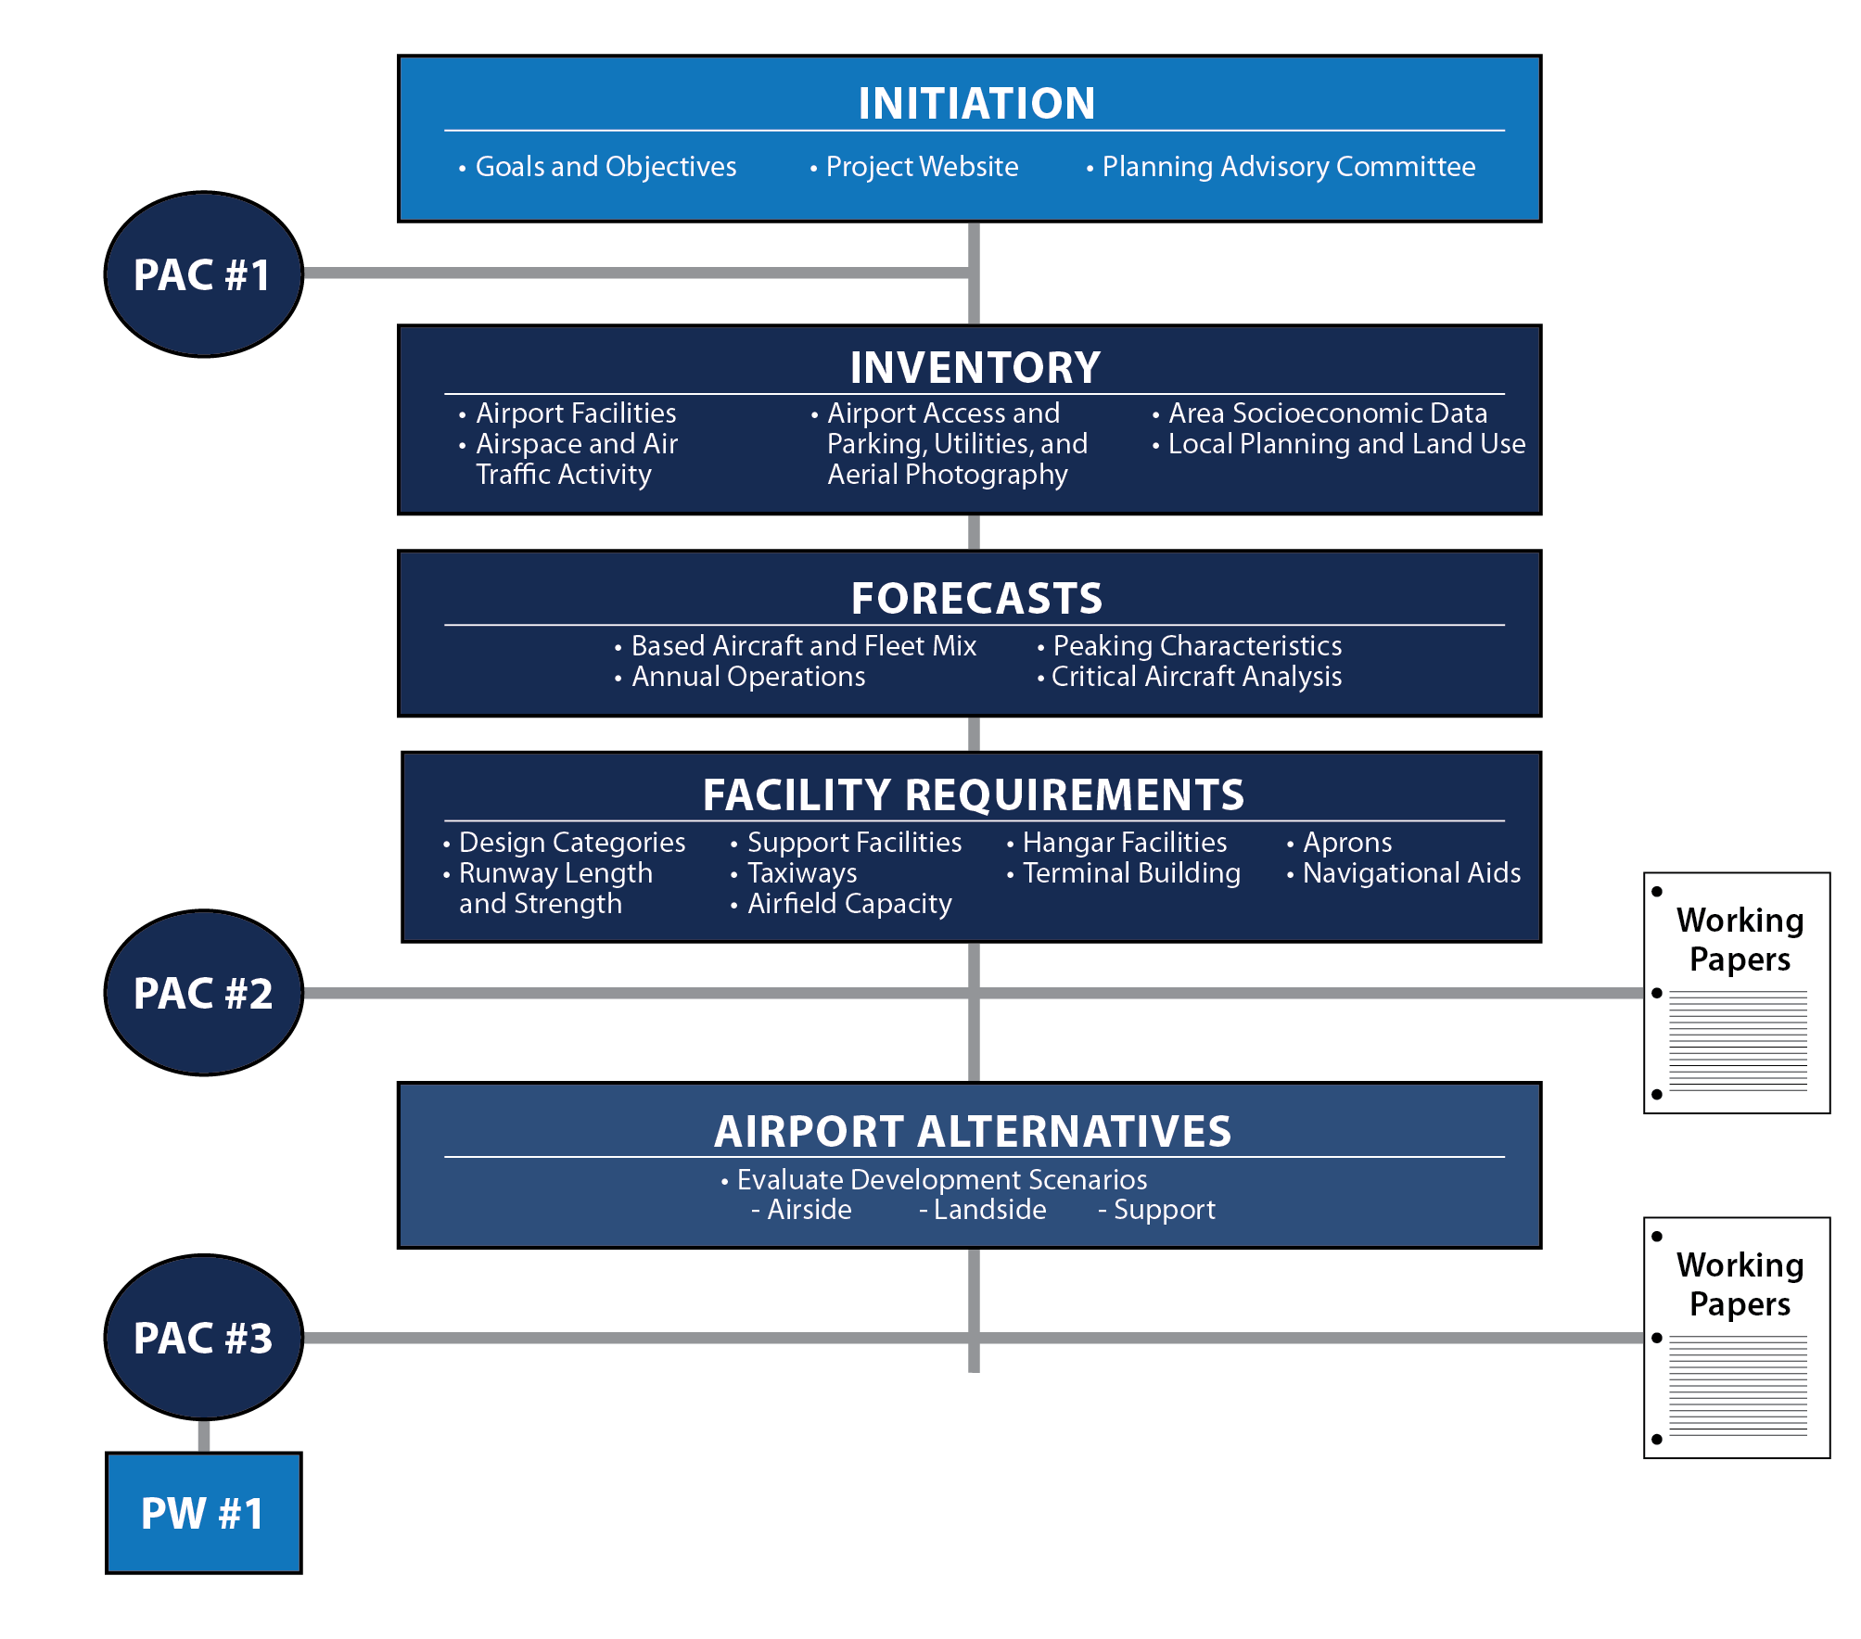

Slide 6
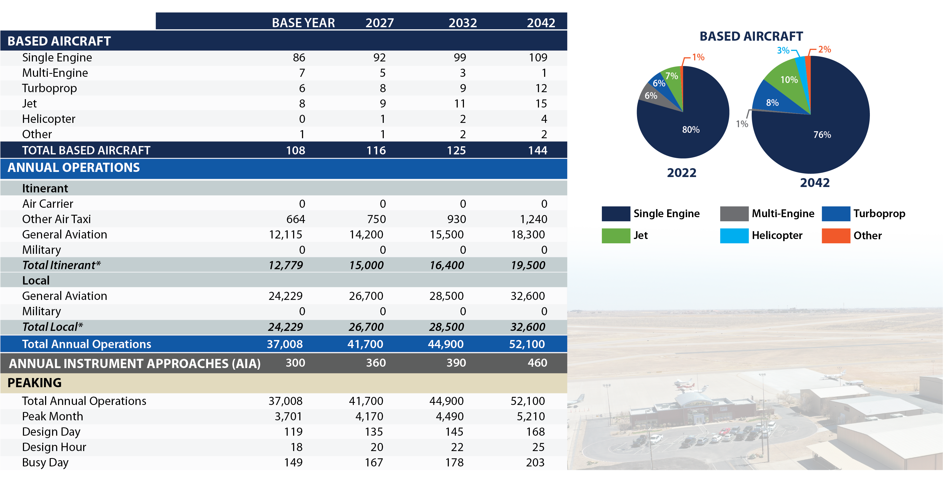
Forecast Summary

Slide 7
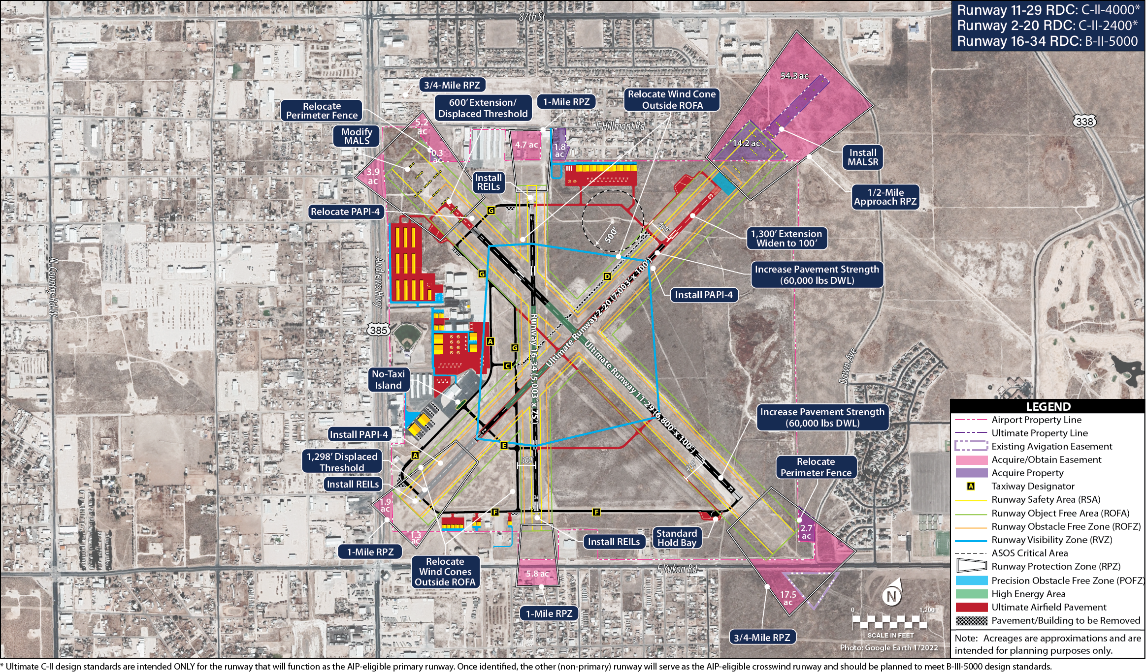
Recommended Development Concept

Slide 8
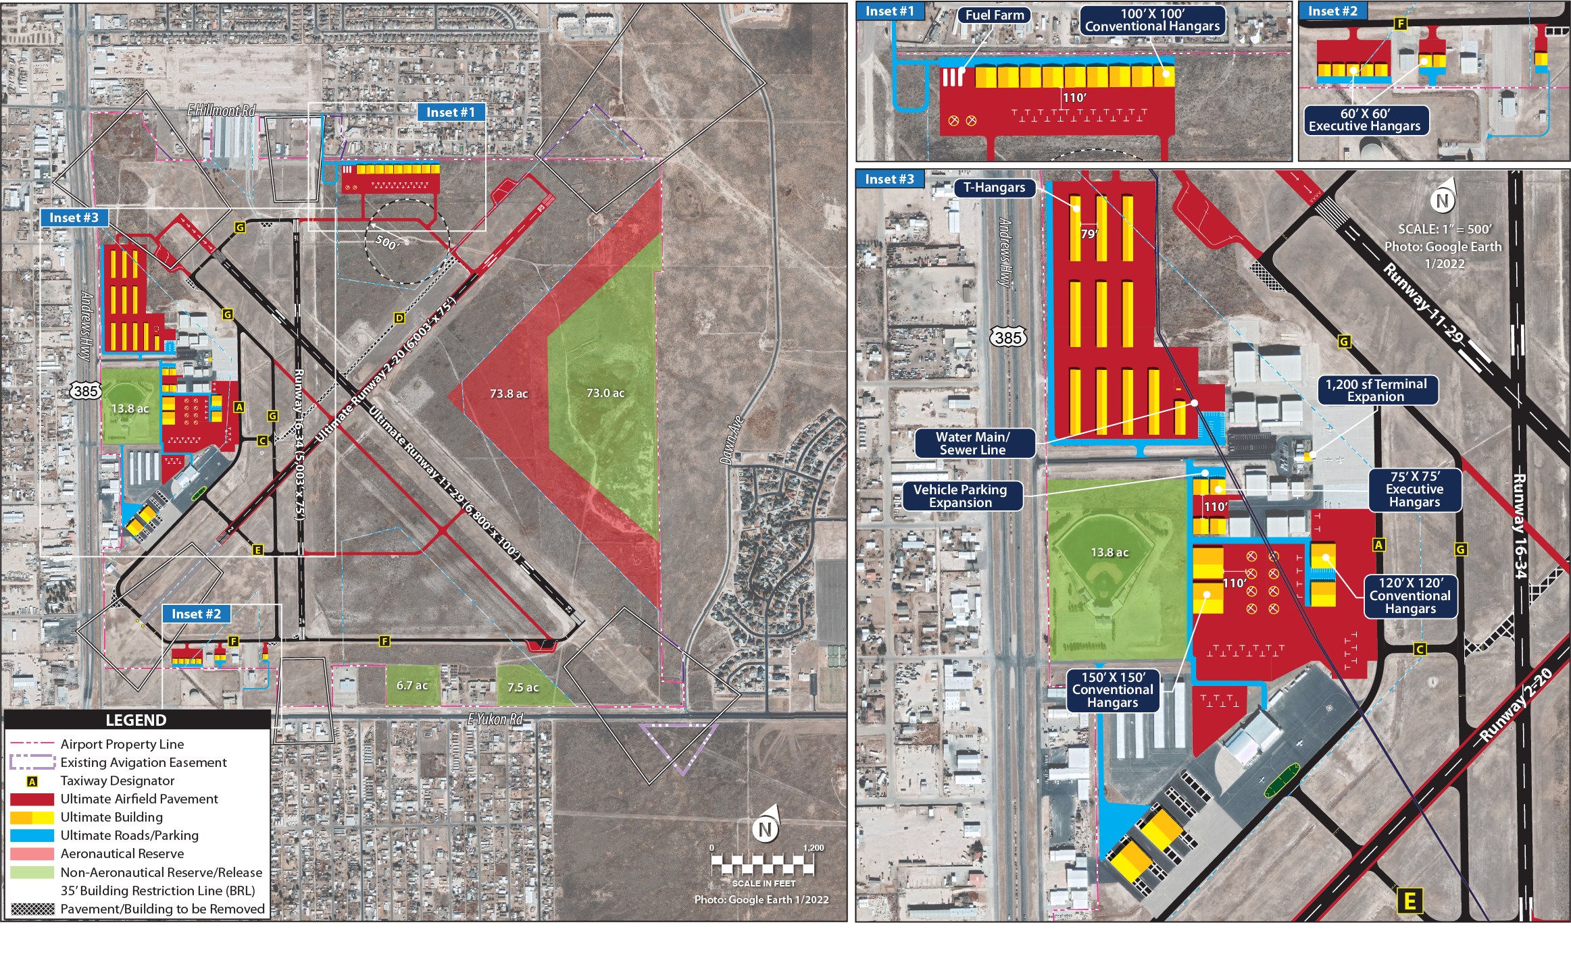
Recommended Landside Development Concept

Slide 9
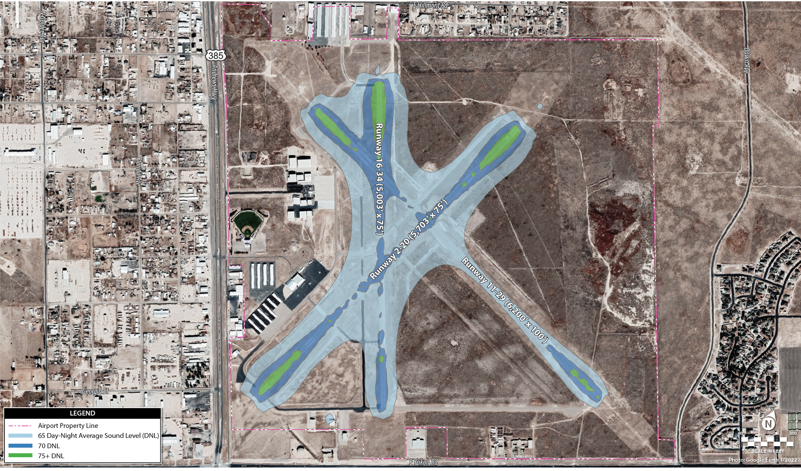
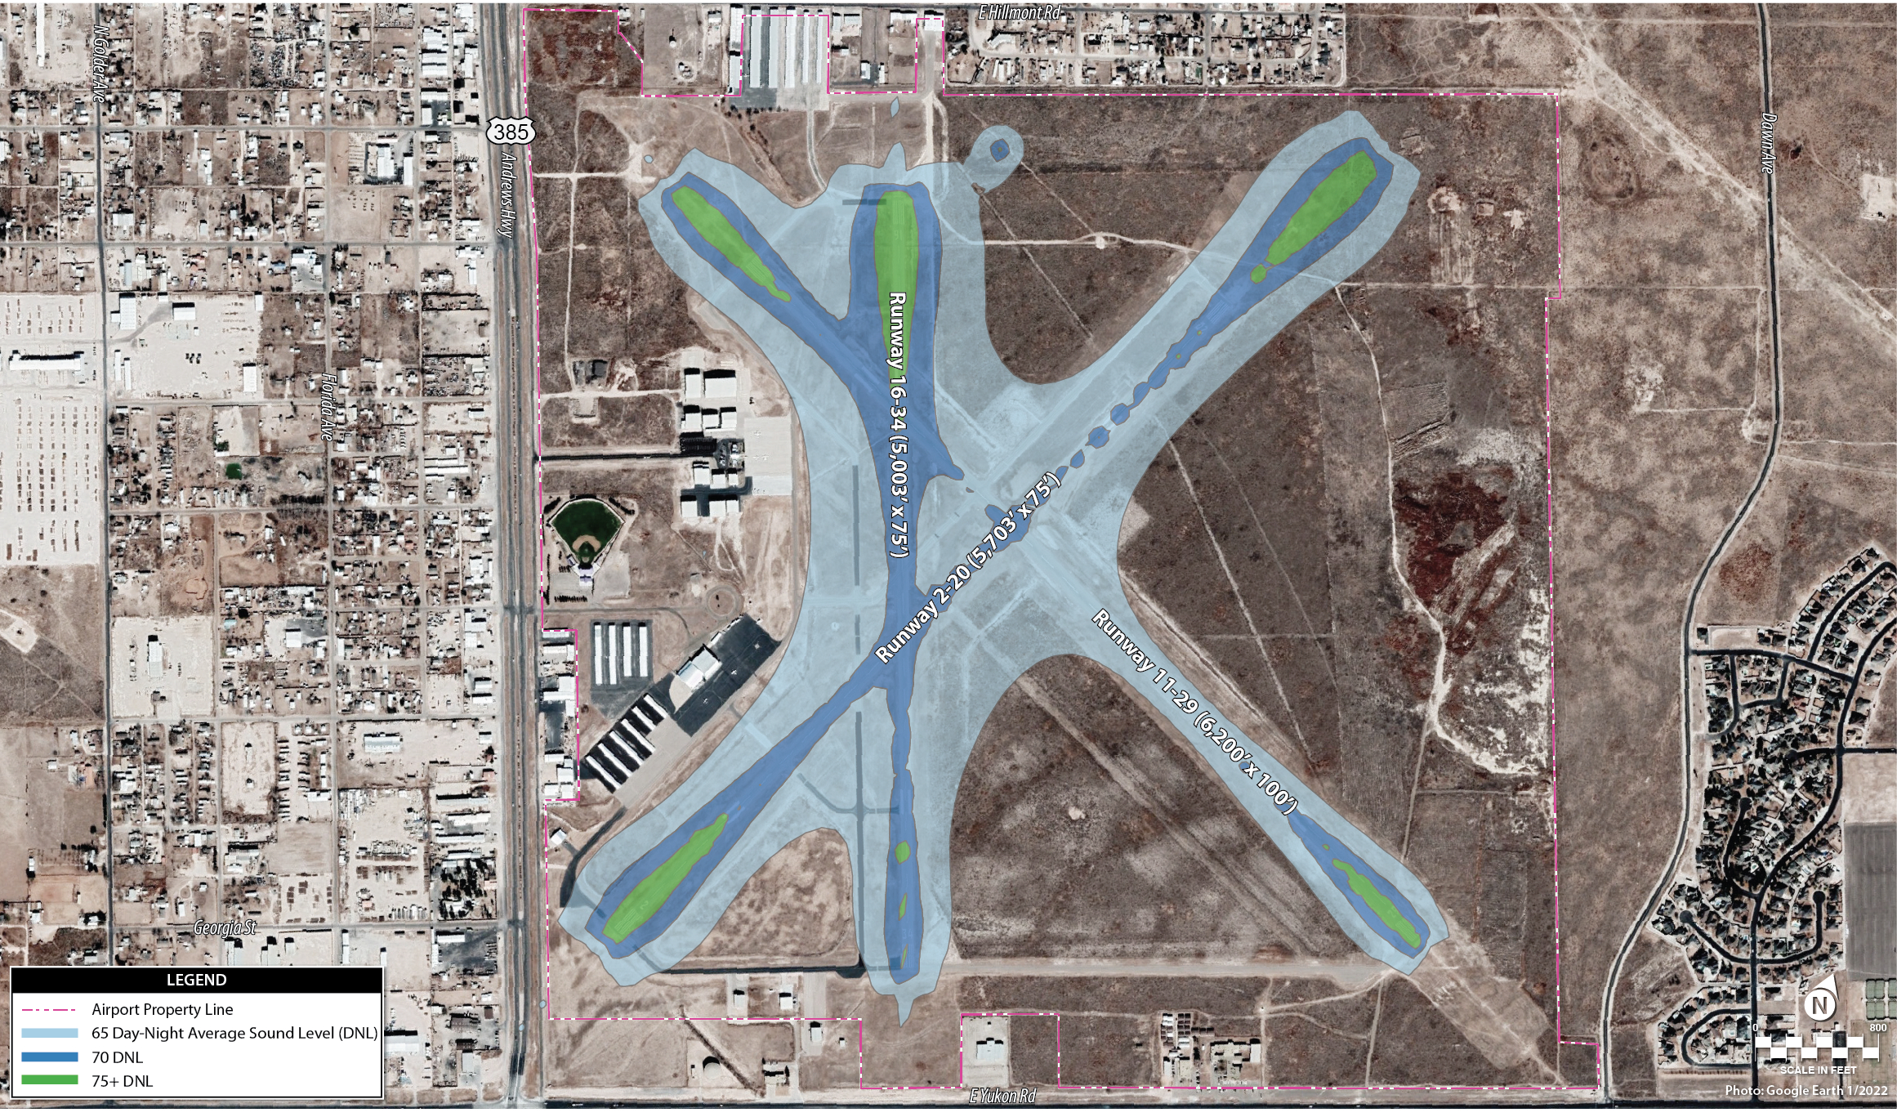
Existing/Ultimate Noise Contours

Slide 10
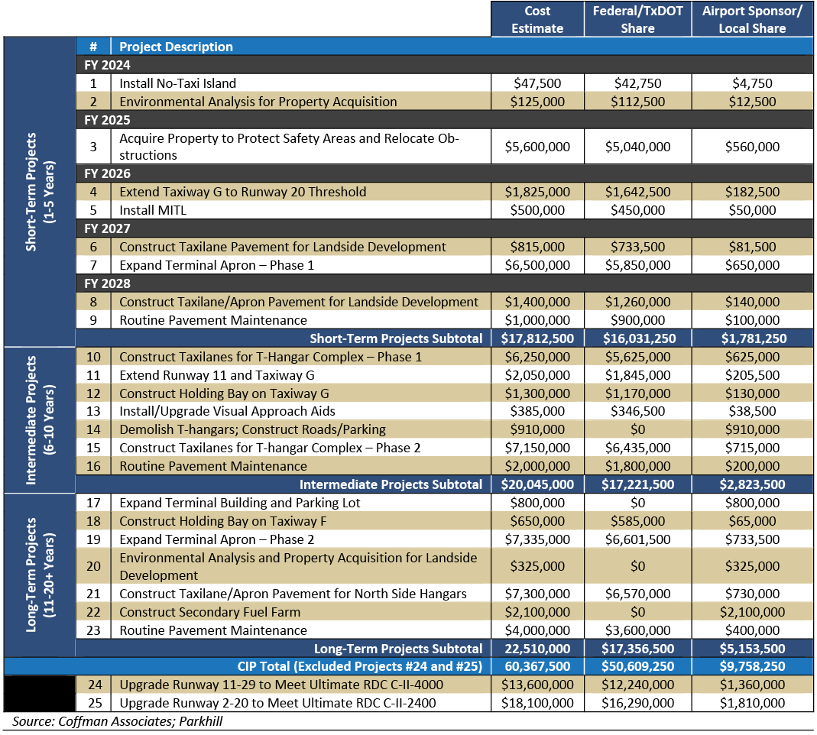
Capital Improvement Program

Slide 11
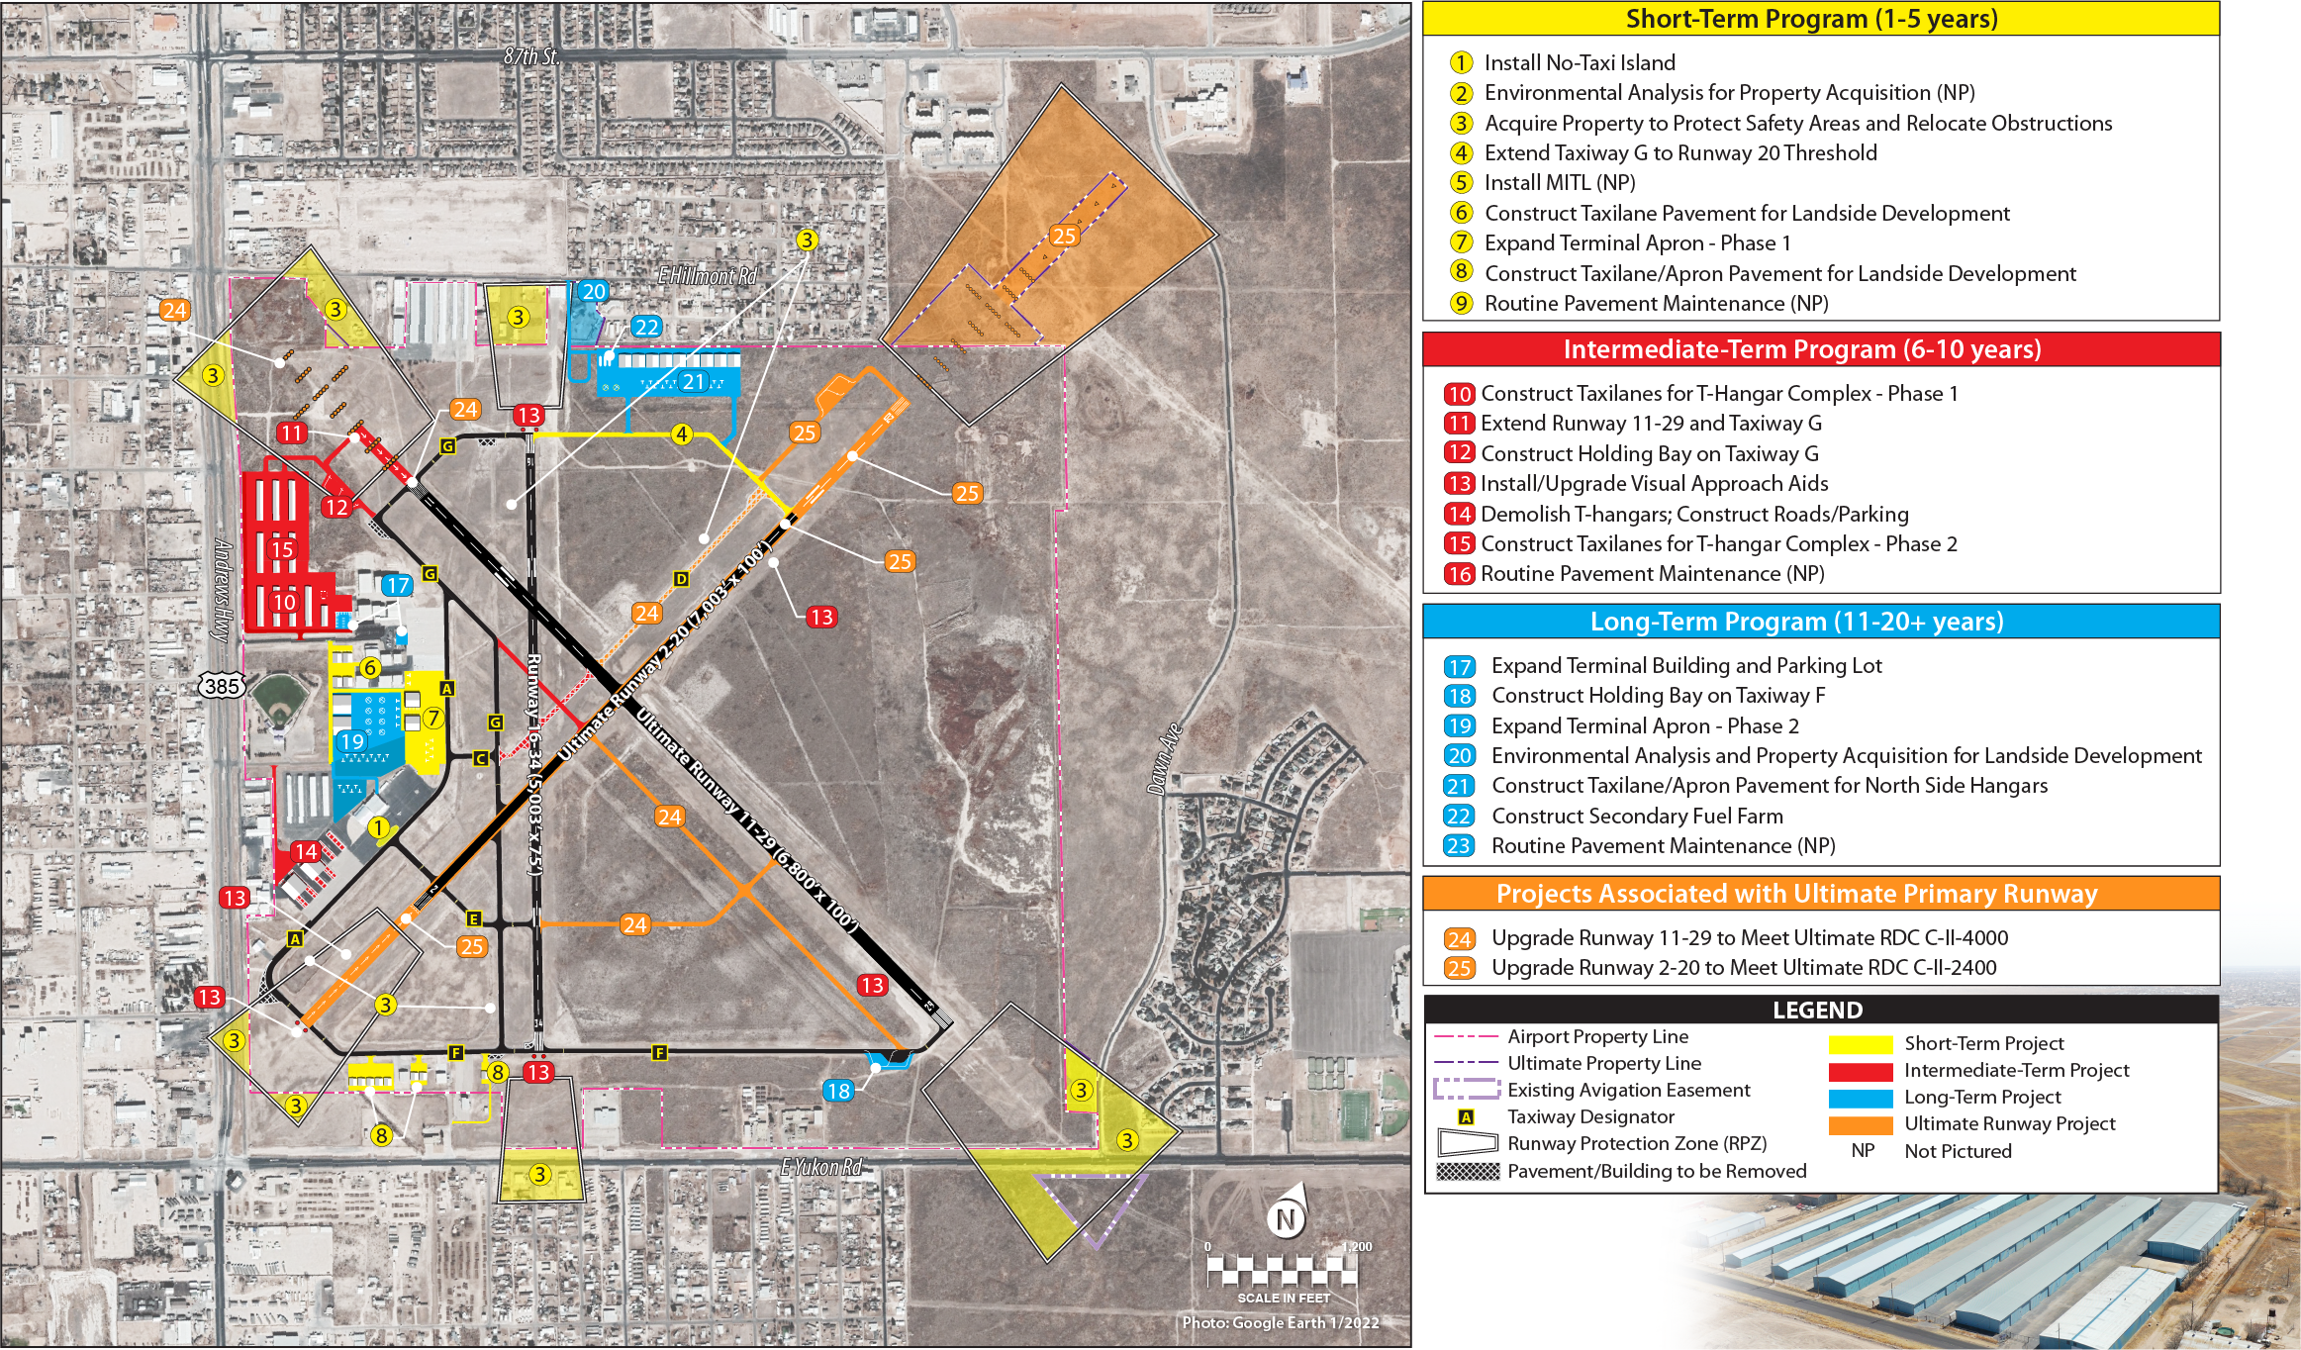
Development Staging

Slide 12
Height/Hazard Zoning
Planning for airport compatible development is a local action that must be tailored to an individual airport
Zoning regulations, threshold displacement, airfield redesign, property acquisition, restrictive covenants, subdivision regulations, etc.
Existing non-standard uses of land or structures are not required to adhere to newly adopted zoning

Slide 13
Height/Hazard Zoning (Cont.)
Airport Overlay Zone
May be superimposed on comprehensive zoning
Specifies land uses that are not permitted
Controlled compatible land use zone extends 5 miles beyond runway ends and 1.5 miles on each side of extended runway centerline
Part 77 surfaces are minimum areas that should be protected

Slide 14
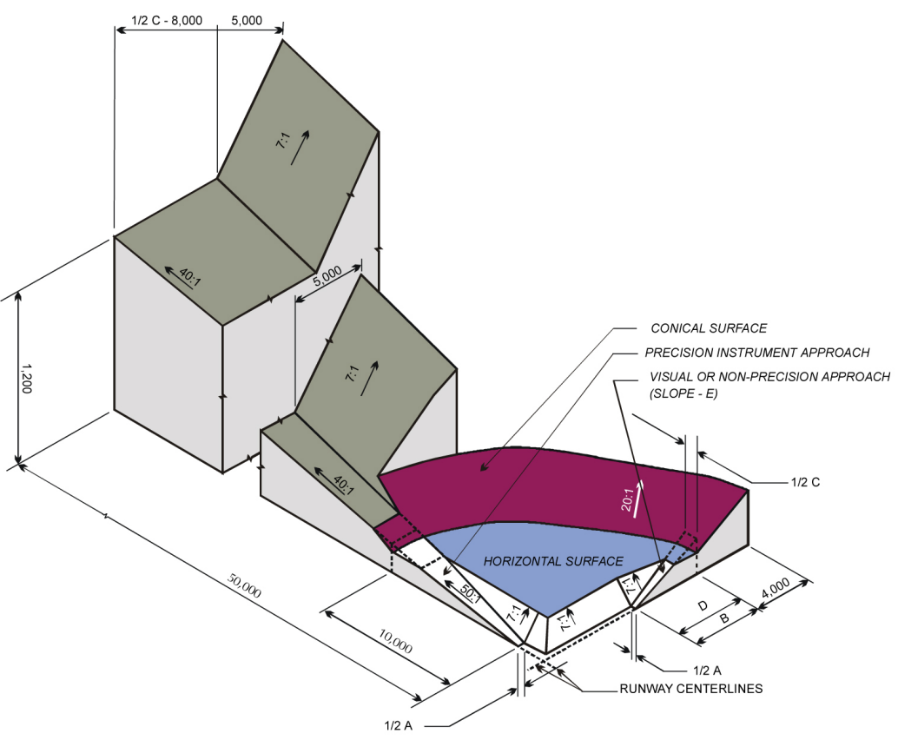
FAR Part 77
The Part 77 imaginary surfaces are:
Primary Surface
Approach Surface
Transitional Surface
Horizontal Surface
Conical Surface

Slide 15
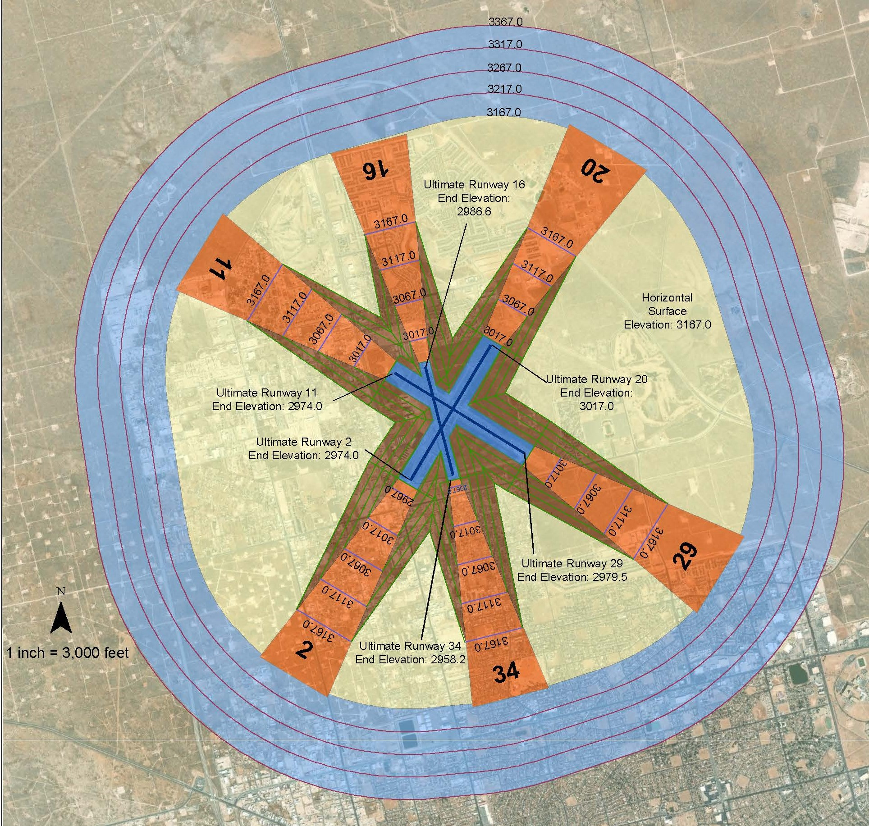
Ultimate FAR Part 77 Surfaces for ODO
87th St
Hwy 338
LEGEND
Primary Surface
Approach Surface
Transitional Surface
Horizontal Surface
Conical Surface
Hwy 385
Yukon Rd
FM 1882
Parkway Blvd
E 52nd St

Slide 16
QUESTIONS?
We want to hear from you!
Direct any questions or comments after this meeting to Chandra Burks
with Coffman Associates at 816-524-3500 or cburks@coffmanassociates.com
or visit the project website to submit comments online.
www.odo.airportstudy.net

